Slide 1


Smaller Models, Bigger Impact: Evidence-Based Zero-Shot Extraction of Nanoparticle Design Parameters from Scientific Literature
Halidu (Khalid, but not DJ Khaled) Abdulai
Åbo Akademi University
13.11.2025
1

Slide 2




Non-Animal Platform for Nanoparticle-Based Delivery across the blood-brain barrier Interface with Vehicle Evolution (NAP4DIVE)
(Department of Engineering & IT Team)
Prof. Dr. Sebastien Lafond Team Lead
Dr. Hergys Rexha
Postdocotral Researcher
Qianqian Xia
Doctoral Researcher
Halidu Abdulai
Doctoral Researcher
13.11.2025
2

Slide 3

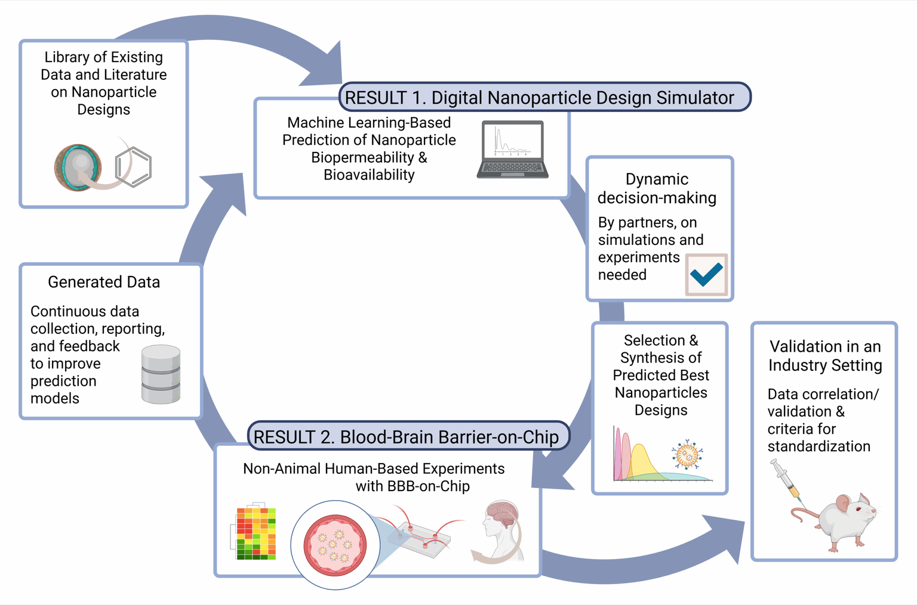
13.11.2025
3

Slide 4
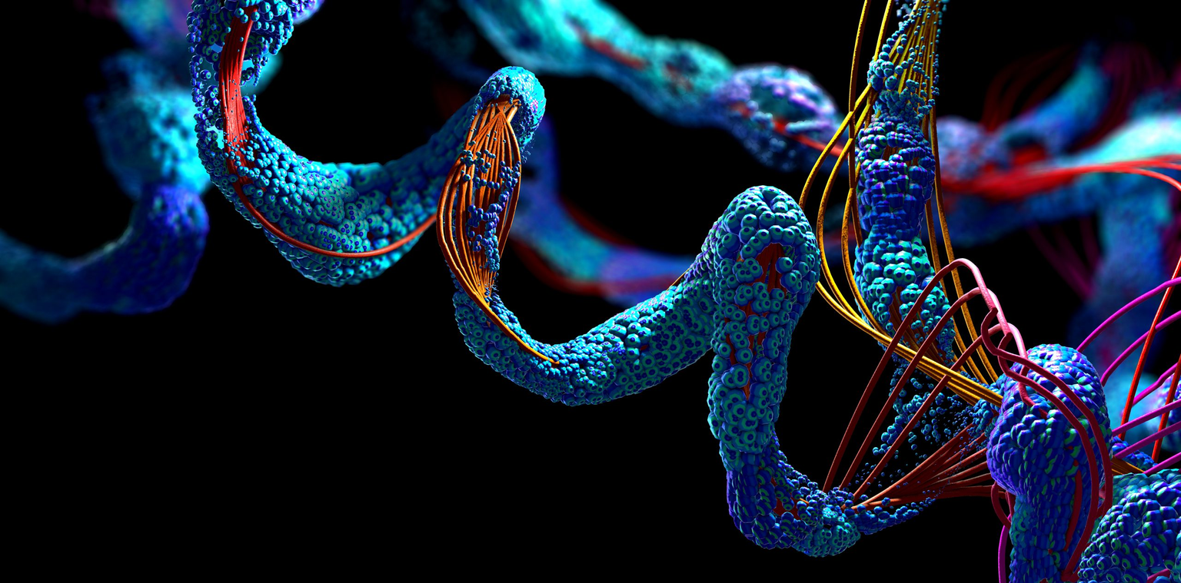
Back to the matter... AI in drug discovery
AlphaFold for Protein structure prediction
Speeds up structural biology with fast, accurate 3D protein prediction
Accelerates target discovery by revealing disease-relevant structures
Image credit: SciLifeLab
13.11.2025
4

Slide 5
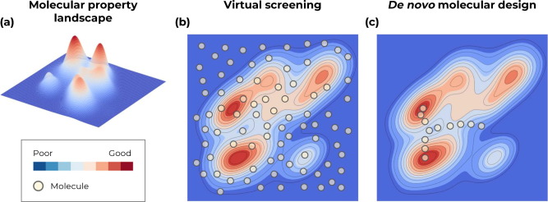
Back to the matter... AI in drug discovery
Generative AI for de novo molecule design
Explores vast chemical space to propose novel, diverse scaffolds
Optimizes multi-parameter profiles (potency, selectivity, ADMET) by design
Speeds hit & lead discovery with rapid, model-driven iteration
Image credit: De novo molecular design and generative models; https://doi.org/10.1016/j.drudis.2021.05.019
13.11.2025
4

Slide 6
What made these possible?
13.11.2025
5

Slide 7
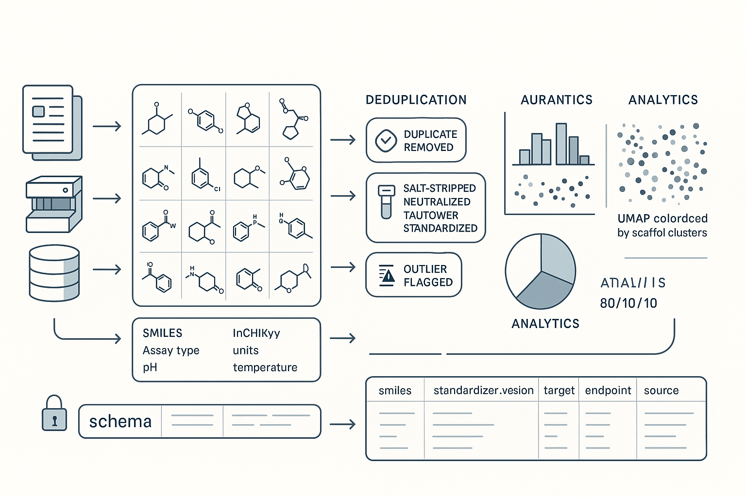
All these possibilities are, in part, powered by large, quality datasets
ChEMBL: curated bioactivities linking compounds to targets
PubChem BioAssay: large HTS assay results used to train predictive models.
BindingDB: experimentally measured protein–ligand affinities for training/scoring.
DrugBank: drug/target knowledgebase used in ML and repurposing.
AlphaFold DB: Protein structures for structure-based models
13.11.2025
5

Slide 8
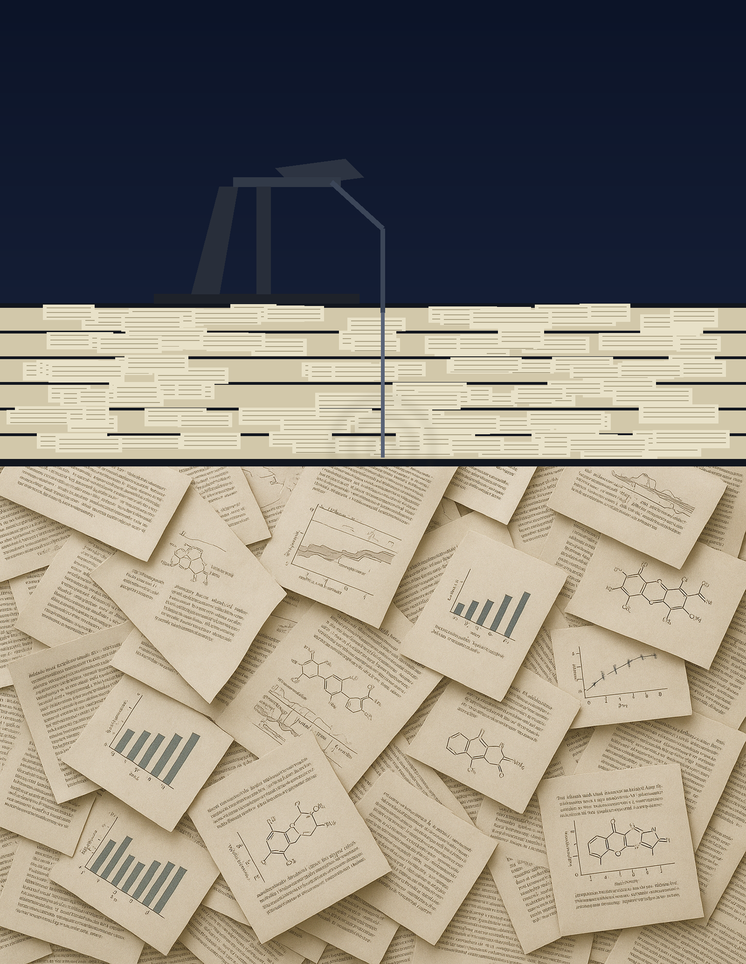
“Data is the new [crude] oil”
Vast amount of unstructured text available
How do we transform it into structured data?
13.11.2025
5

Slide 9

The “not so nice” approach
Manual extraction
13.11.2025
5

Slide 10
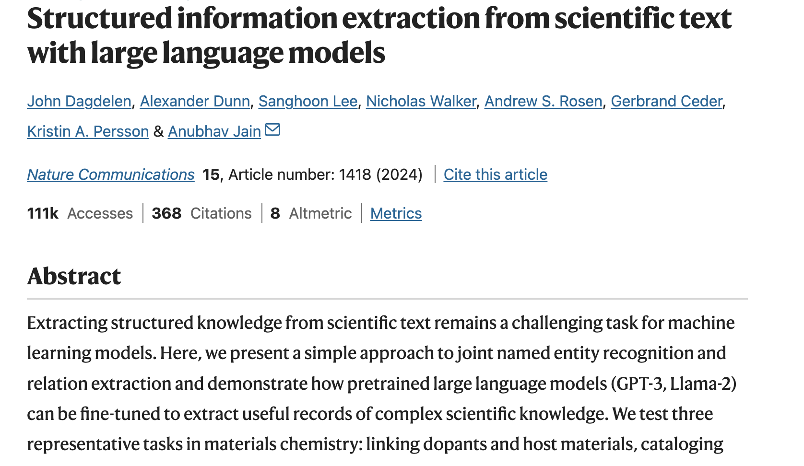
On a rescue mission
13.11.2025
5
Notes:
"Data is the new cruide oil"
And that wasn't a lie. Indeed, it is like crude oil. And it is less usable in its raw form; we need to mine and extract it into a machine-readable format to make the best out of it.

Slide 11
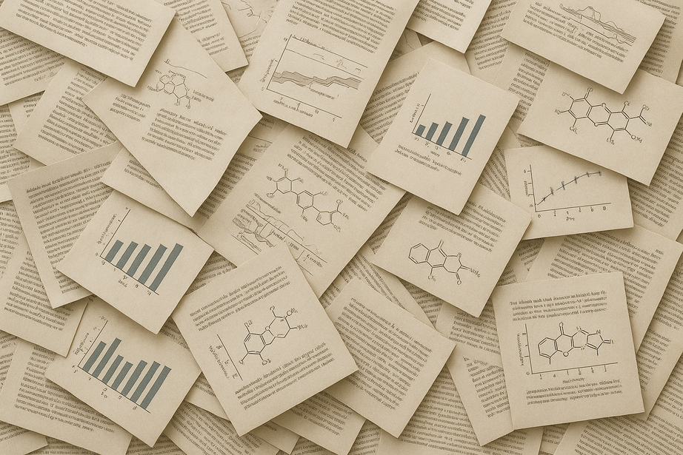

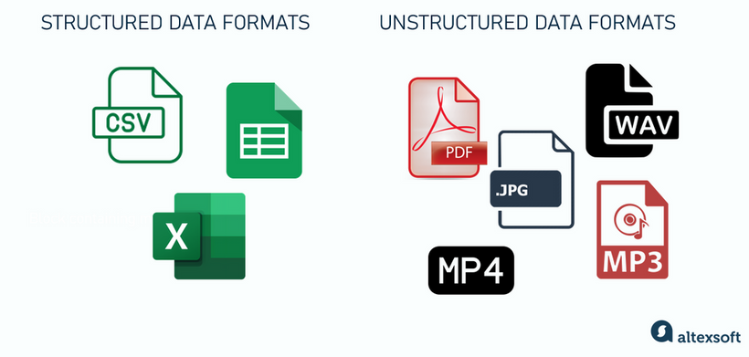
LLMs for Information Extraction
13.11.2025
5
Notes:
"Data is the new cruide oil"
And that wasn't a lie. Indeed, it is like crude oil. And it is less usable in its raw form; we need to mine and extract it into a machine-readable format to make the best out of it.

Slide 12
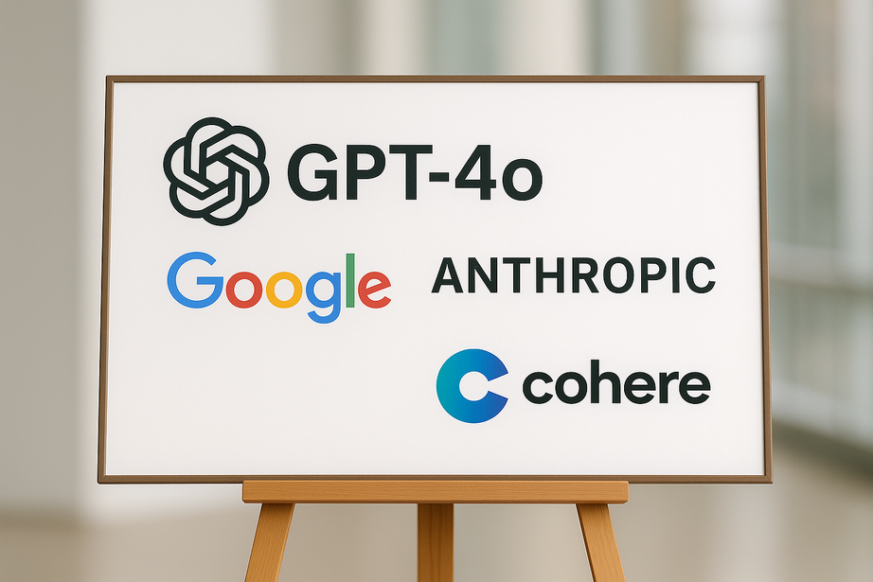
LLMs for Information Extraction
Large, closed-source LMs are well established
13.11.2025
7
Notes:
"Data is the new cruide oil"
And that wasn't a lie. Indeed, it is like crude oil. And it is less usable in its raw form; we need to mine and extract it into a machine-readable format to make the best out of it.

Slide 13
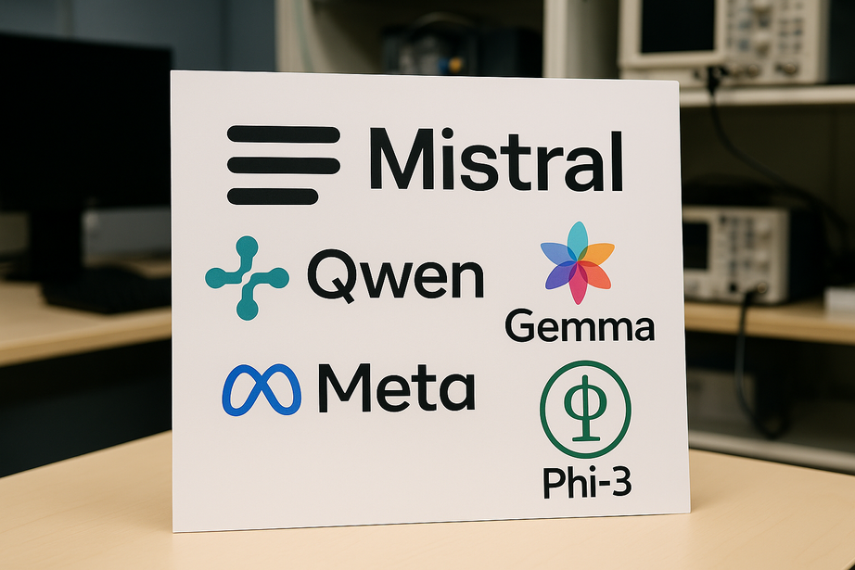
LLMs for Information Extraction
Large, closed-source LMs are well established
Small, open-source LMs are catching up!
13.11.2025
7
Notes:
"Data is the new cruide oil"
And that wasn't a lie. Indeed, it is like crude oil. And it is less usable in its raw form; we need to mine and extract it into a machine-readable format to make the best out of it.

Slide 14
Why are SLMs gaining grounds?
"A Jack of all trades, is a master of none"
Less compute power requiremnts
Compared to LLMs, less data is required to perform fine-tuning.
Privacy and data control
Predictability and control
13.11.2025
8
Notes:
"Data is the new cruide oil"
And that wasn't a lie. Indeed, it is like crude oil. And it is less usable in its raw form; we need to mine and extract it into a machine-readable format to make the best out of it.

Slide 15
The situationship
Sometimes we are just a bit unlucky: no task-specific fine-tuning dataset
What do we do?
13.11.2025
9
Notes:
"Data is the new cruide oil"
And that wasn't a lie. Indeed, it is like crude oil. And it is less usable in its raw form; we need to mine and extract it into a machine-readable format to make the best out of it.

Slide 16
The situationship
Sometimes we are just a bit unlucky: no task-specific fine-tuning dataset
Zero-shot vs Few-shots prompting
13.11.2025
9
Notes:
"Data is the new cruide oil"
And that wasn't a lie. Indeed, it is like crude oil. And it is less usable in its raw form; we need to mine and extract it into a machine-readable format to make the best out of it.

Slide 17
“There is magic in them strategies”
The way the model is instructed
The way the model is used
But how do we achieve these?
13.11.2025
10
Notes:
"Data is the new cruide oil"
And that wasn't a lie. Indeed, it is like crude oil. And it is less usable in its raw form; we need to mine and extract it into a machine-readable format to make the best out of it.

Slide 18

The way the model is instructed
Go buy me bread
13.11.2025
11
Notes:
"Data is the new cruide oil"
And that wasn't a lie. Indeed, it is like crude oil. And it is less usable in its raw form; we need to mine and extract it into a machine-readable format to make the best out of it.

Slide 19

The way the model is instructed
Go buy me bread
Go buy me bread for sandwich
13.11.2025
11
Notes:
"Data is the new cruide oil"
And that wasn't a lie. Indeed, it is like crude oil. And it is less usable in its raw form; we need to mine and extract it into a machine-readable format to make the best out of it.

Slide 20

The way the model is instructed
Go buy me bread
Go buy me bread for sandwich
Go buy me "Sandwich bread" for sandwich
13.11.2025
11
Notes:
"Data is the new cruide oil"
And that wasn't a lie. Indeed, it is like crude oil. And it is less usable in its raw form; we need to mine and extract it into a machine-readable format to make the best out of it.

Slide 21
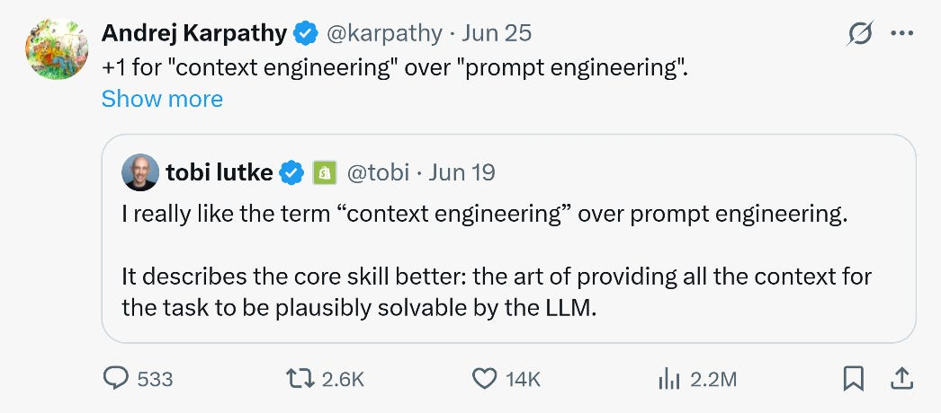
The way the model is instructed
The way the model is instructed: Context engineering
13.11.2025
11
Notes:
"Data is the new cruide oil"
And that wasn't a lie. Indeed, it is like crude oil. And it is less usable in its raw form; we need to mine and extract it into a machine-readable format to make the best out of it.

Slide 22
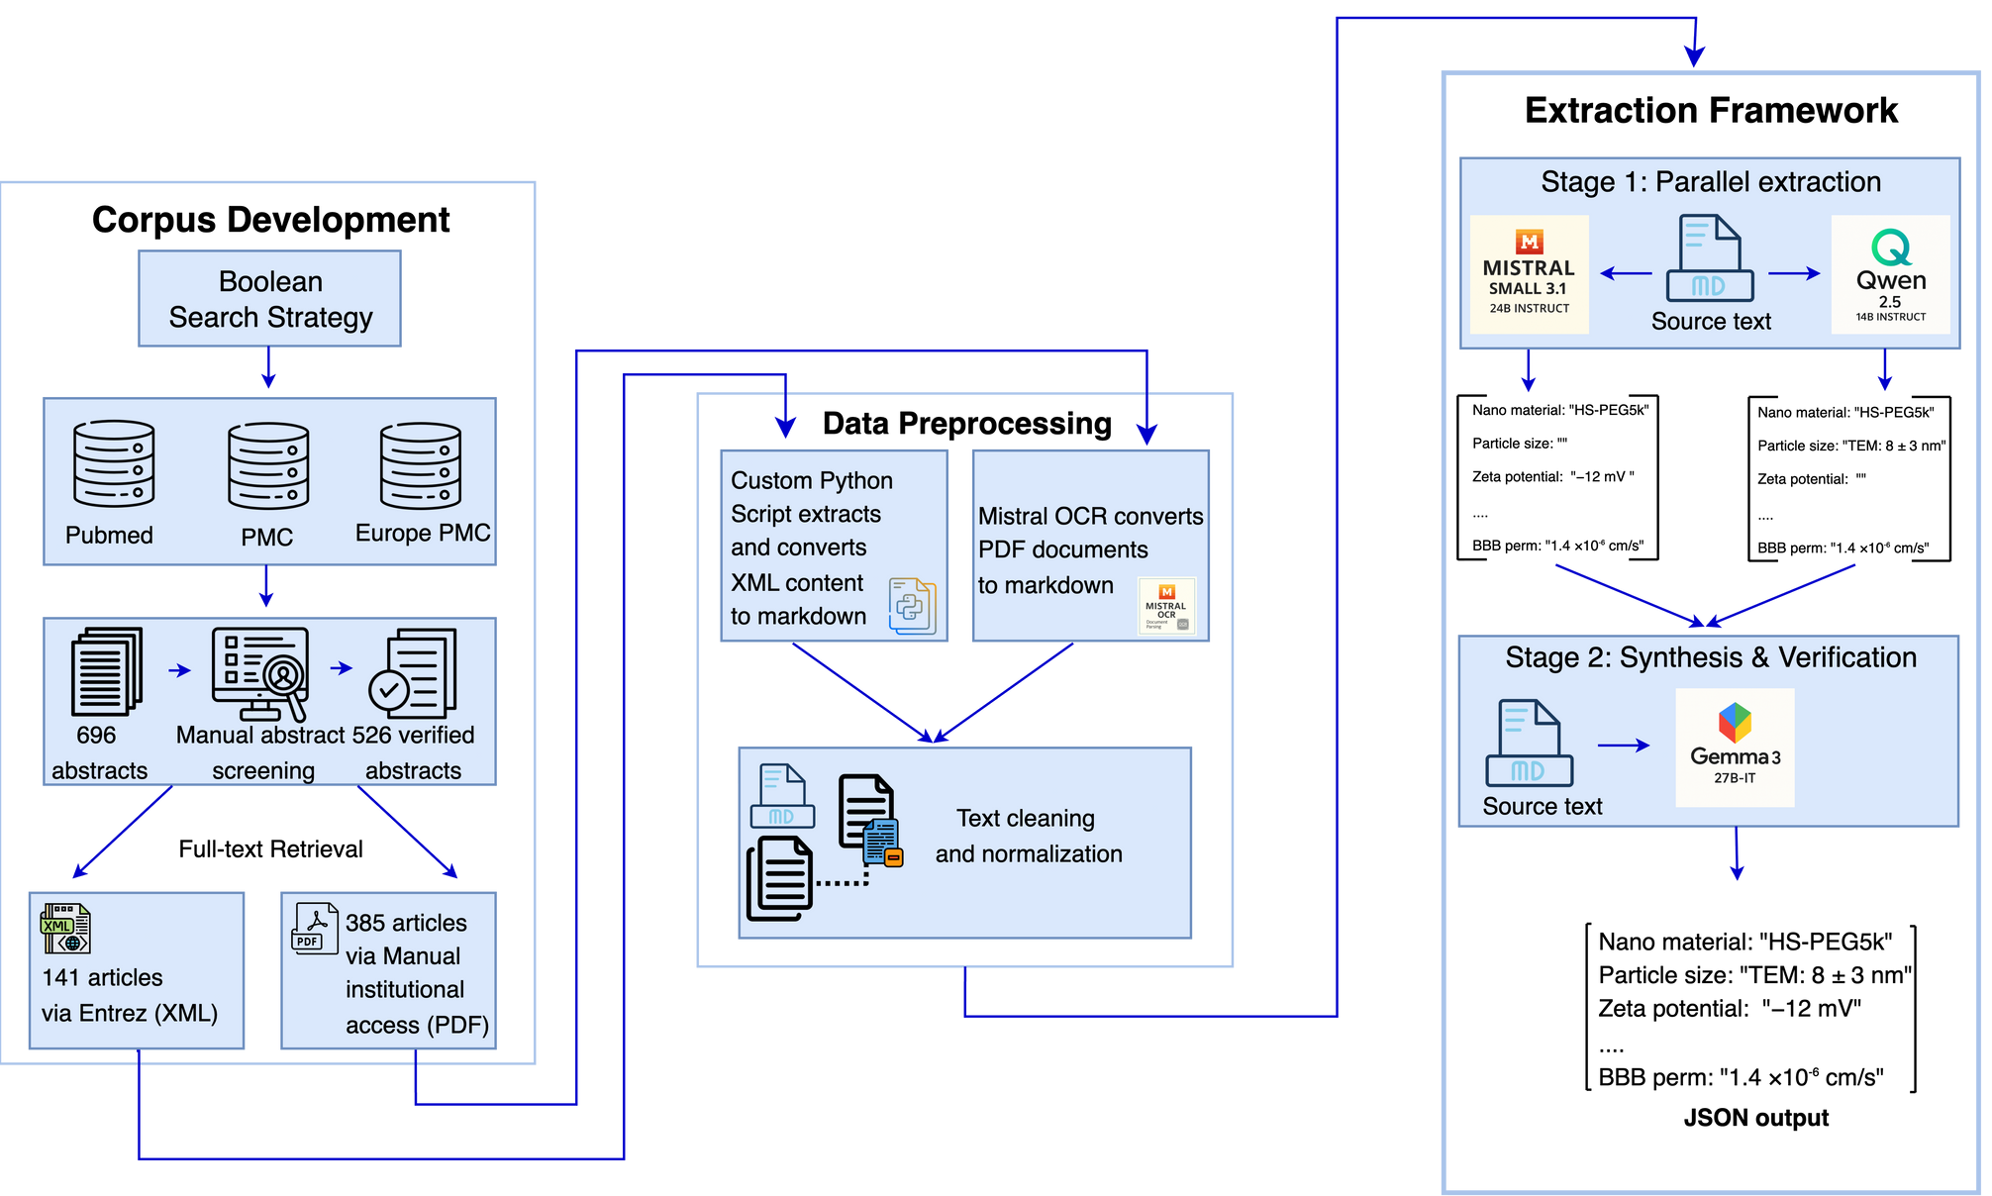
The way the model used
13.11.2025
12
Notes:
"Data is the new cruide oil"
And that wasn't a lie. Indeed, it is like crude oil. And it is less usable in its raw form; we need to mine and extract it into a machine-readable format to make the best out of it.

Slide 23
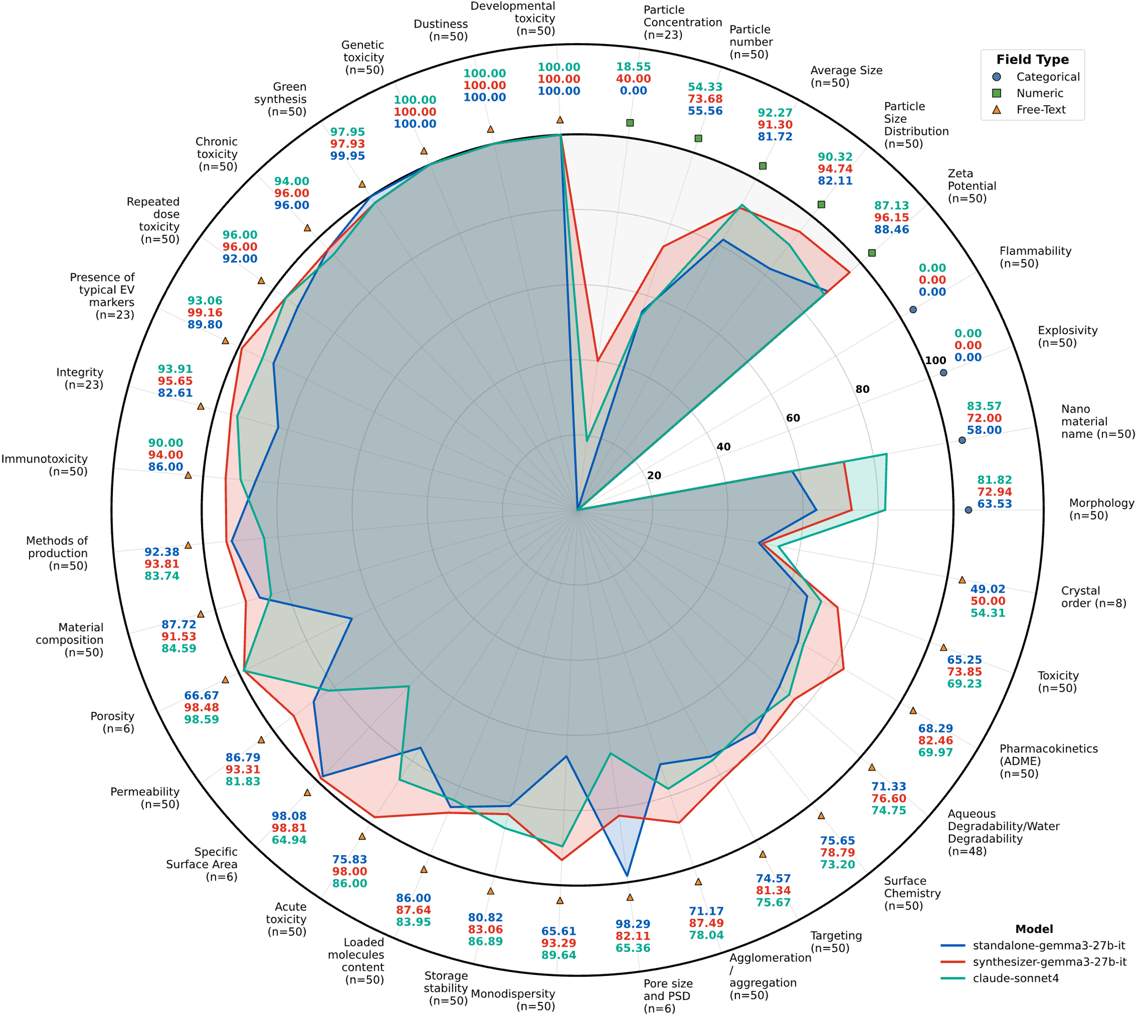
Extracting BBB-NP design params
13.11.2025
13
Notes:
"Data is the new cruide oil"
And that wasn't a lie. Indeed, it is like crude oil. And it is less usable in its raw form; we need to mine and extract it into a machine-readable format to make the best out of it.

Slide 24
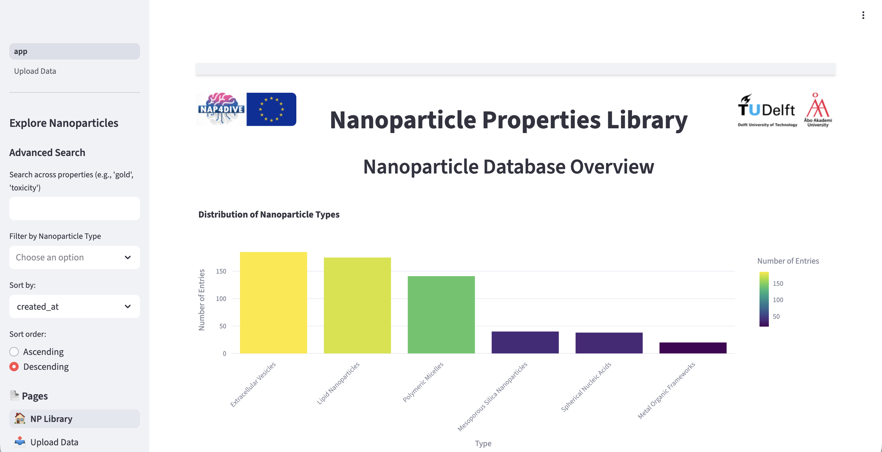

Digital Np library
13.11.2025
13
Notes:
"Data is the new cruide oil"
And that wasn't a lie. Indeed, it is like crude oil. And it is less usable in its raw form; we need to mine and extract it into a machine-readable format to make the best out of it.

Slide 25
Caution: The road is not always smooth
External factors-induced non-deterministic behavior of LMs: Reproducibility at stake?
Lack of discourse-level understanding of text: Task-dependent
13.11.2025
13
Notes:
"Data is the new cruide oil"
And that wasn't a lie. Indeed, it is like crude oil. And it is less usable in its raw form; we need to mine and extract it into a machine-readable format to make the best out of it.

Slide 26
What to tell your wife/husband/sibling(s) at home
Much of the data needed to build AI models for drug discovery is spread across scientific literature
With the right strategies, small, open-weight LMs may extract information at the performance level of closed-source LLMs to support downstream applications
13.11.2025
14
Notes:
"Data is the new cruide oil"
And that wasn't a lie. Indeed, it is like crude oil. And it is less usable in its raw form; we need to mine and extract it into a machine-readable format to make the best out of it.

Slide 27

Thank you!
Any questions?
13.11.2025
15
Notes:
"Data is the new cruide oil"
And that wasn't a lie. Indeed, it is like crude oil. And it is less usable in its raw form; we need to mine and extract it into a machine-readable format to make the best out of it.

